Slide 1
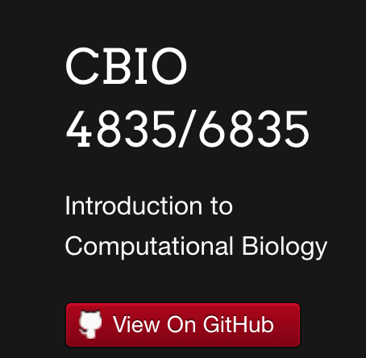
https://eds-uga.github.io/cbio4835-fa18
https://jupyterhub.cs.uga.edu
Requires VPN or on-campus access!
https://eds-uga-cbio4835.slack.com/

Slide 2
Computational Genomics
Systems and Modeling
Computational Structural Biology
Bioimaging
Sequence alignment, dynamic programming, sequence representation
Sequence modeling, compartment models, simulation
Molecular coordinates, molecular dynamics, clustering
Computer vision, object segmentation, video tracking
Python!
Command line
Variables
Data structures
Conditionals
Loops
Functions
Arrays
File I/O
Visualization
Modules
Multitasking

